Slide 1

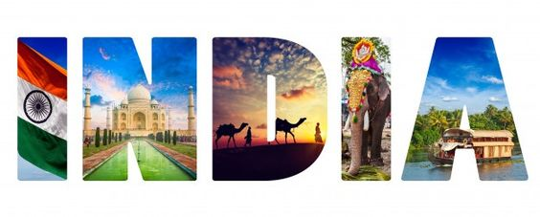
TITLE PAGE Problem Statement : Travel and tourism face sustainability challenges and evolving consumer preferences, impacting growth and environmental preservation. Theme : Travel and Tourism site Team Name: Geek Navi Team Members: Palak Rani , Pooja Shkay ,Tanya Modanwal

Slide 2
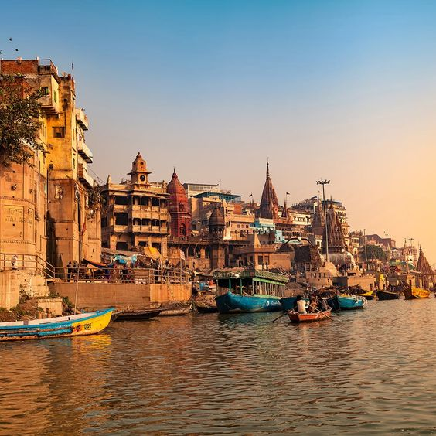
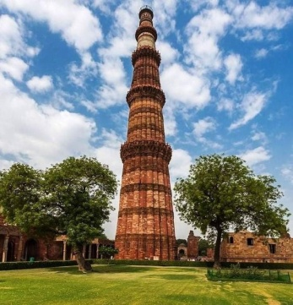
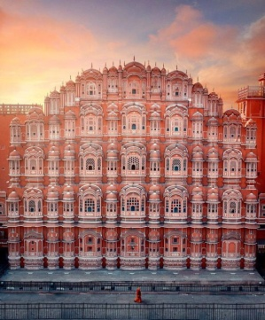
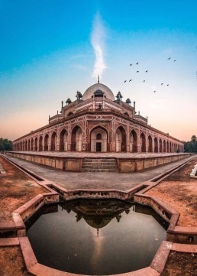
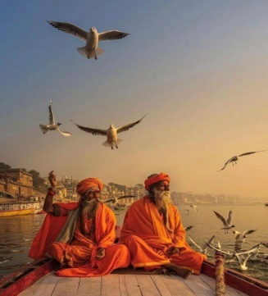
About us:
At Yatra, we believe that travel enriches the soul. Our mission is to provide you with unforgettable travel experiences, whether you’re looking for a relaxing beach getaway, an adventurous mountain trek, or a cultural city tour.
With our extensive network of travel partners, we offer a wide range of services including flight bookings, hotel accommodations, guided tours, and customized travel packages. Our expert team is dedicated to making your travel dreams a reality.
Join us as we explore the world's most beautiful destinations. From breathtaking landscapes to vibrant cultures, let us guide you on your next adventure. Experience the joy of travel with Yatra.

Slide 3
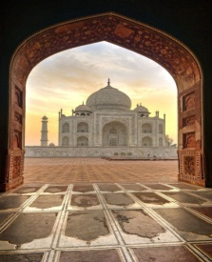
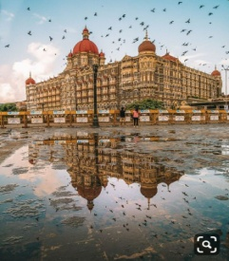
Travel Packages:
Experience the iconic cities of Delhi, Agra, and Jaipur in this classic tour. Visit the Taj Mahal, explore palaces, and indulge in local cuisine.
Relax and rejuvenate in the serene backwaters of Kerala. Enjoy houseboat rides, lush landscapes, and authentic Kerala cuisine.
Enjoy the sun, sand, and surf in Goa. This package includes beach activities, nightlife, and a taste of Goa's vibrant culture
Explore the royal heritage of Rajasthan, including magnificent forts and palaces in cities like Udaipur, Jaisalmer, and Jaipur.

Slide 4
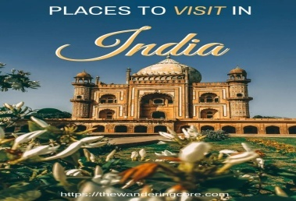

Destinations:
Your journey to the heart of India starts here!
Home to the magnificent Taj Mahal, Agra is a city rich in history and architectural beauty. Experience the grandeur of Mughal architecture.
Known as the Pink City, Jaipur boasts stunning forts, palaces, and vibrant markets. Don’t miss the Hawa Mahal and Amber Fort!
Famous for its lush backwaters, tranquil beaches, and rich culture, Kerala is a perfect destination for relaxation and adventure.
Renowned for its stunning beaches, vibrant nightlife, and delicious seafood, Goa is a haven for sun-seekers and party lovers.
One of the oldest cities in the world, Varanasi is a spiritual hub where you can experience the mesmerizing Ganga Aarti.

Slide 5
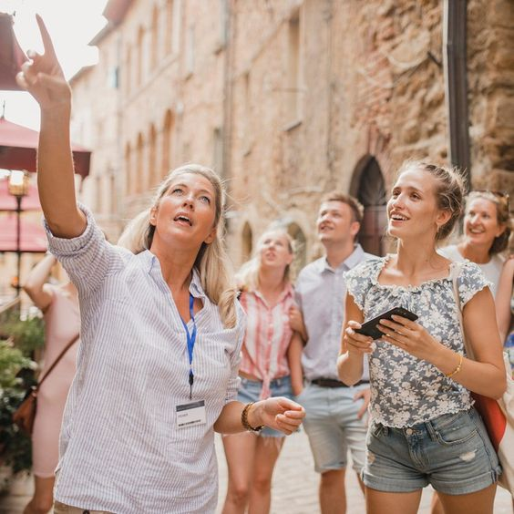
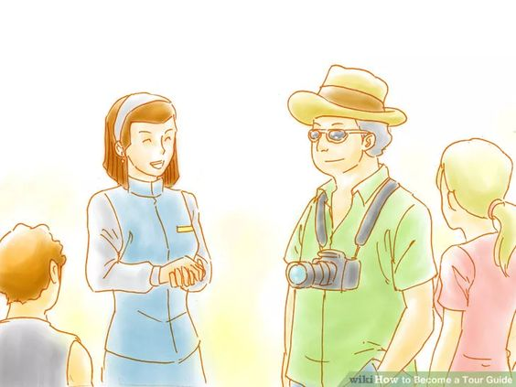
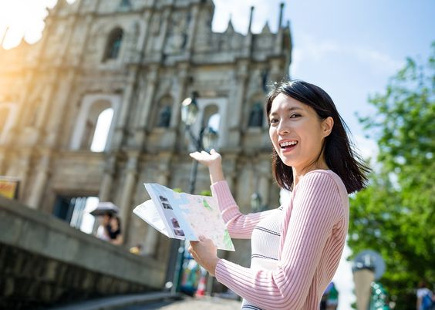
Careers:
Travel Consultant : Help clients plan their dream vacations. Experience in travel is preferred.
Tour Guide : Lead groups on exciting tours. Must have excellent communication skills.
Marketing Specialist : Develop marketing strategies to promote our services. Creativity is key!
Employees

Slide 6
Explore:
From the explore site you can explore different famous spots all over the country.
Check out exclusive deals:
Check out the exclusive deals for different hotels from different parts of India.

Slide 7
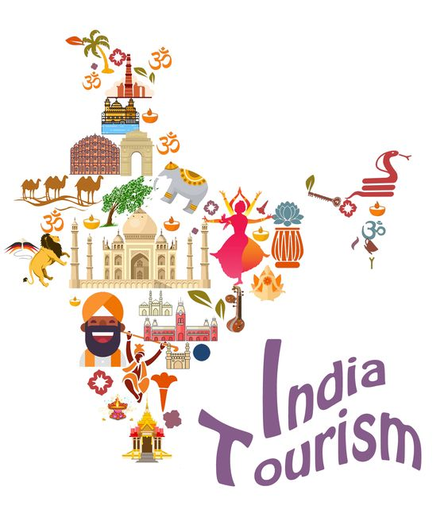
Customer reviews and explorer articles:
This part shows the review from various explorers.
It also show articles from various explorers.
The end of the site shows links of various social media platform where people can follow and know about our company more.

Slide 8
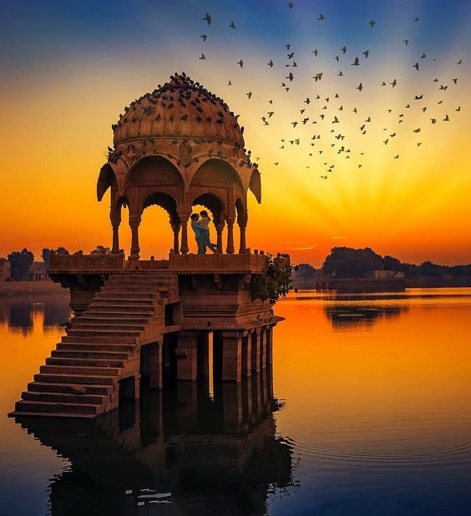
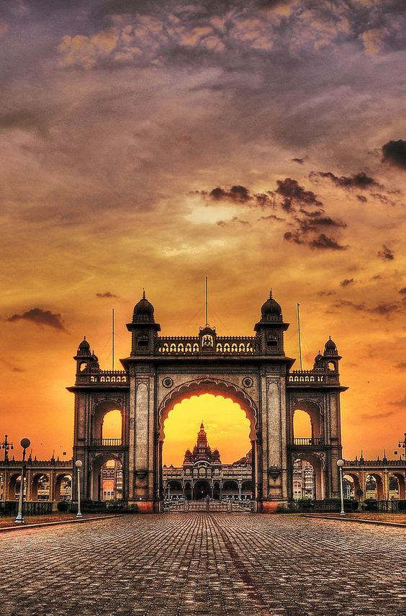
Login and Sign up Page:
Login page helps us to login the website.
Sign up page helps us to signup the website.

Slide 9
THANK YOU Have a great day ☺

